Slide 1




The GEMOC Initiative
ICSA Conference, April, 2017
Benoit Combemale (Inria & Univ. Rennes 1)
http://people.irisa.fr/Benoit.Combemale
benoit.combemale@irisa.fr
@bcombemale
Notes:
Social Coordination in the Globalization of Modeling Languages

Slide 2
"Software languages are software too"
J-M. Favre, D. Gasevic, R. Lämmel, and E. Pek. "Empirical language analysis in software linguistics," In Software Language Engineering, volume 6563 of LNCS, pages 316–326. Springer, 2011.
The GEMOC Initiative – B. Combemale (Univ. Rennes 1) – 2017

Slide 3
Software Language Engineering (SLE)
Application of systematic, disciplined, and measurable approaches to the development, deployment, use, and maintenance of software languages
Various shapes and ways to implement software languages
External, internal or embedded DSLs, Profile, etc.
Grammar, metamodel, ontology, etc.
Supported by various kind of "language workbench"
Eclipse EMF, Xtext, Sirius, Melange (, GEMOC, Papyrus
Jetbrain’s MPS
Spoofax
MS DSL Tools
Etc.
More and more literature, a dedicated Intl. conference (ACM SLE, cf. http://www.sleconf.org)…
The GEMOC Initiative – B. Combemale (Univ. Rennes 1) – 2017

Slide 4
"A clear challenge, then, is how to integrate multiple DSLs."
J. Whittle, J. Hutchinson, and M. Rouncefield, “The State of Practice in Model-Driven Engineering,” IEEE Software, vol. 31, no. 3, 2014, pp. 79–85.

Slide 5
Multiplication of DSLs
Increasing number of
application domains
Increasing number of
stakeholders and
concerns
- 5

Slide 6


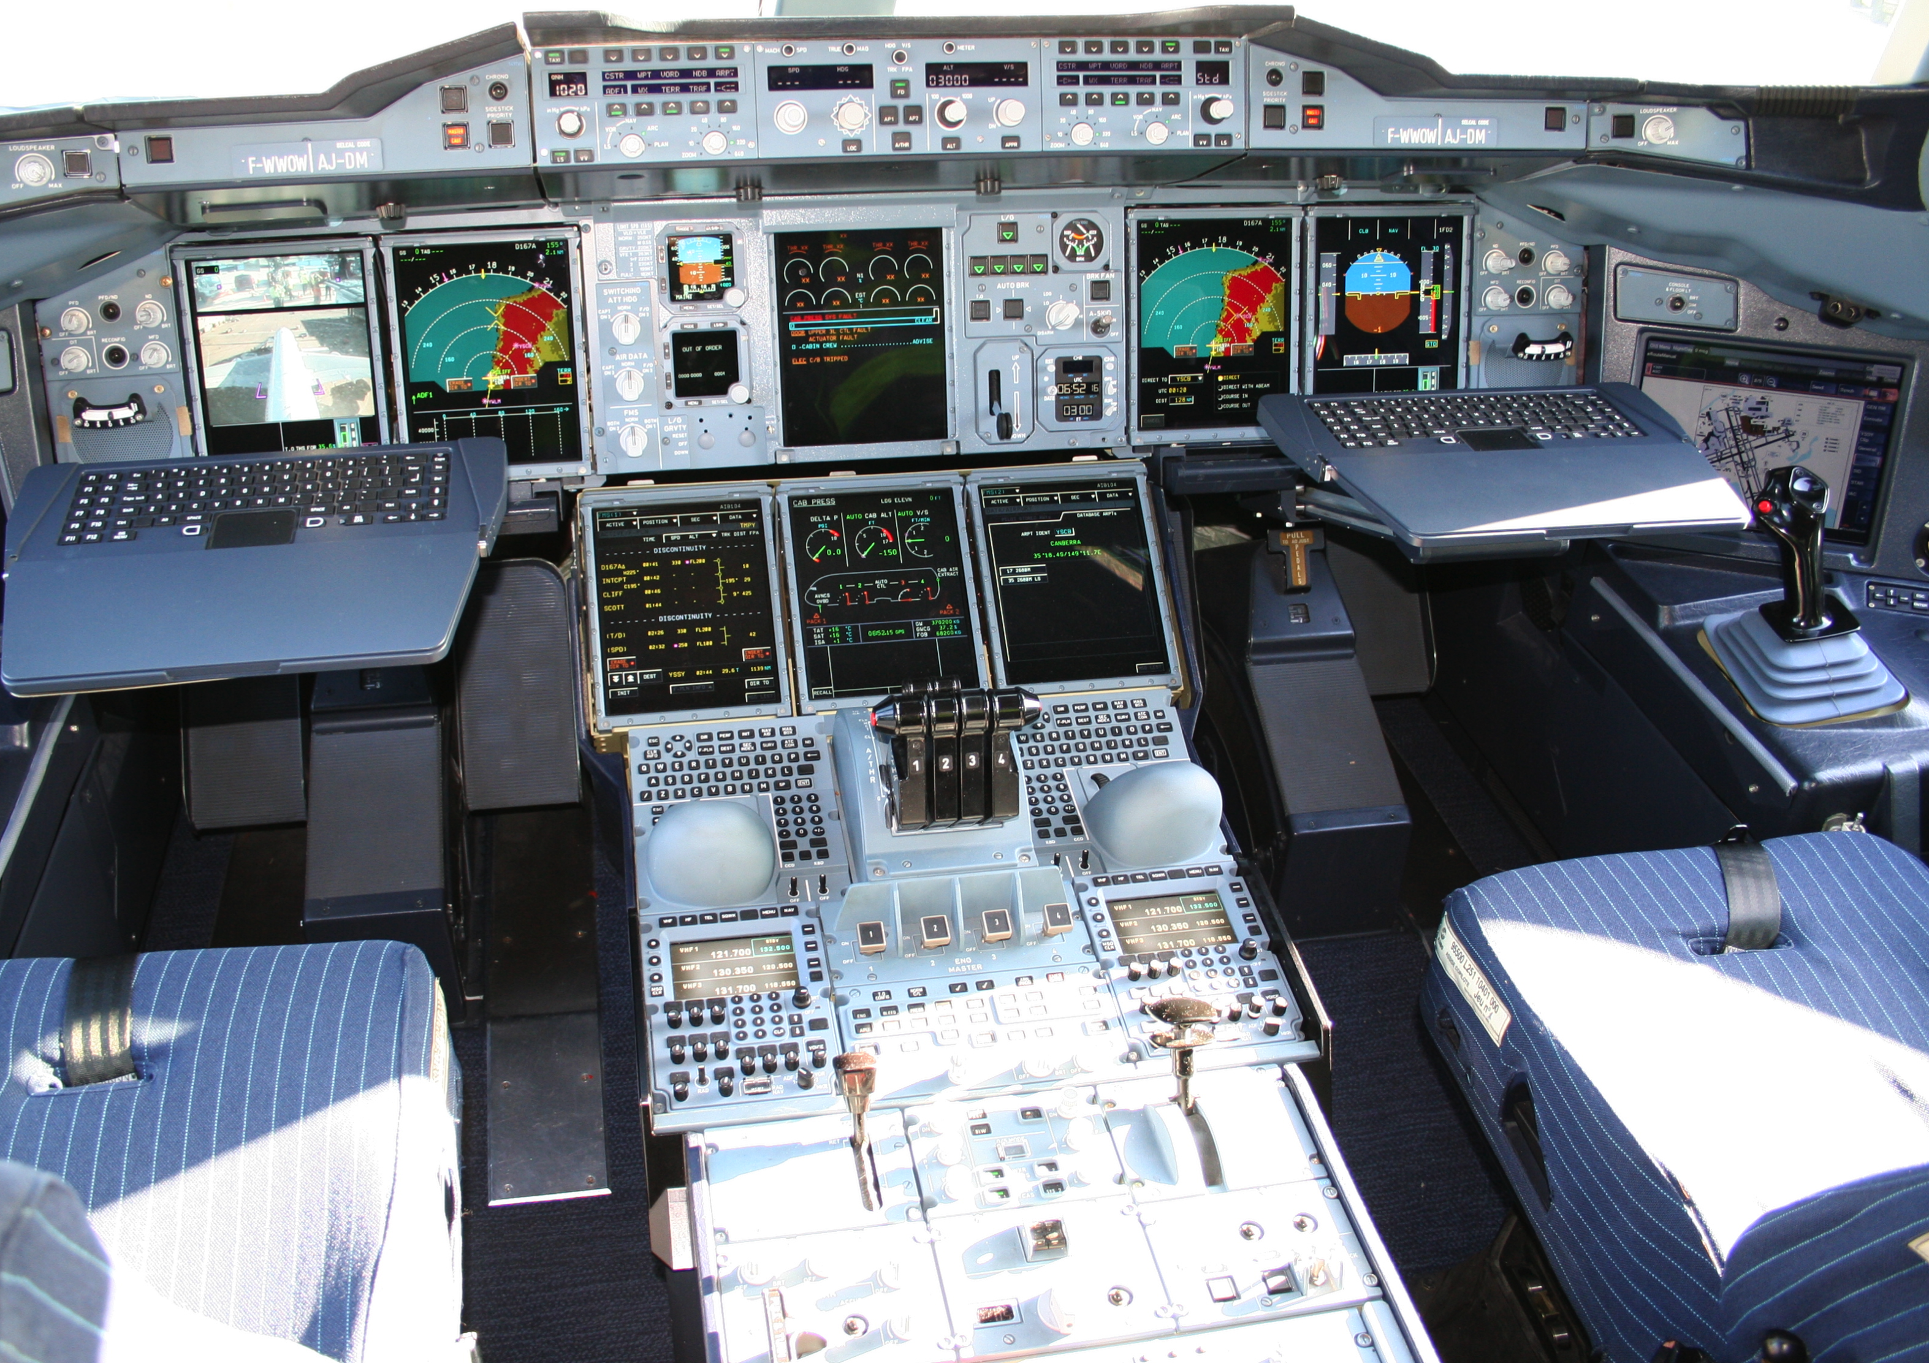









Mechanical
Structure
Airlines
Human-Machine Interaction
Avionics
Multiple
Concerns
Aerodynamics
Environmental
Impact
Propulsion
System
Safety
Regulations
Communications
Authorities
Navigation
Notes:
This piece of complex software integrates different perspectives from these stakeholders
Physics, communications, Pilots -> HCI

Slide 7
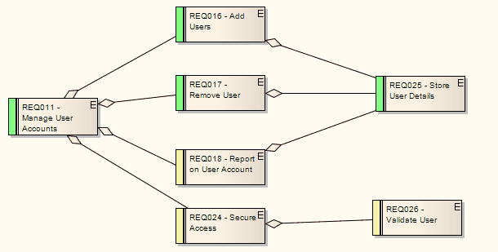
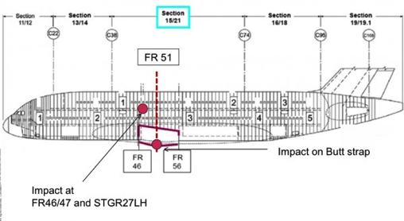
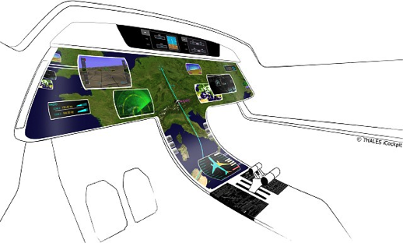
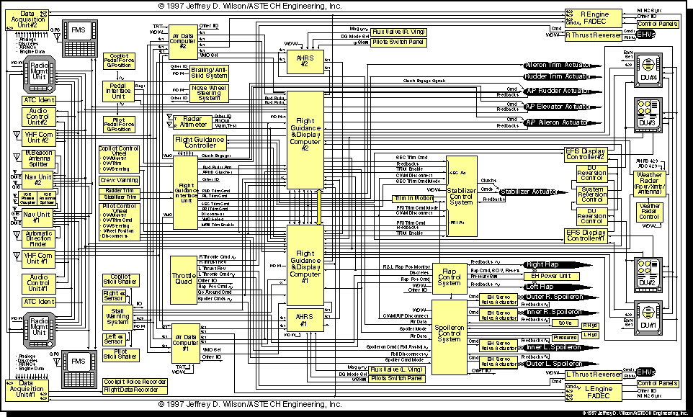
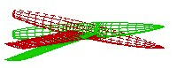
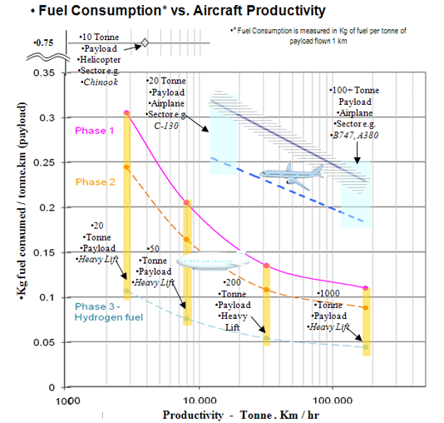
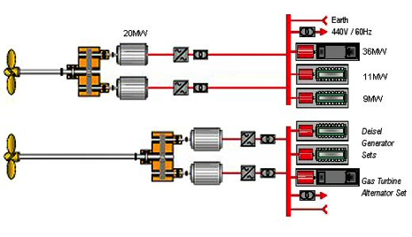
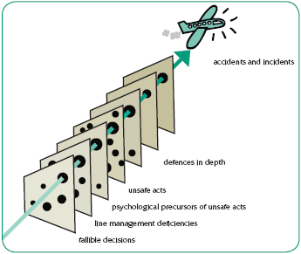
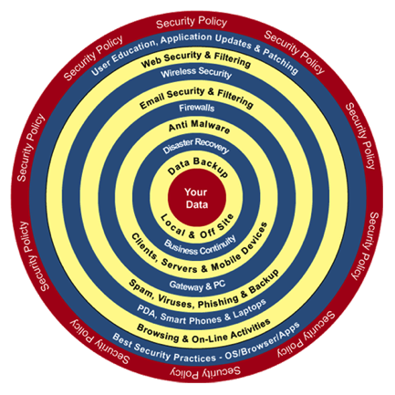
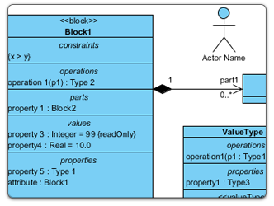
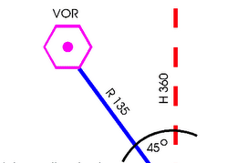
Mechanical
Structure
Airlines
Human-Machine Interaction
Avionics
Heterogeneous Modeling
Aerodynamics
Environmental
Impact
Propulsion
System
Safety
Regulations
Communications
Authorities
Navigation
Notes:
Parler ici du positionnement avec la co-simulation

Slide 8
Towards Language Interfaces
A language interface is a contract that exhibits the relevant information for a given purpose (i.e., to support specific composition operators)
Model type
(for language reuse)
Symbolic event structure
(for behavioral coordination)
"On Language Interfaces," Thomas Degueule, Benoit Combemale, Jean-Marc Jézéquel. PAUSE: Present And Ulterior Software Engineering, 2017. Cf. https://hal.inria.fr/hal-01424909v1
- 8

Slide 9
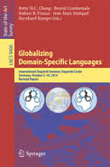
Globalization of Modeling Language
Context: new emerging DSML in open world
impossible a priori unification
require a posteriori globalization
Objective: socio-technical coordination to support interactions across different system aspects
Language-based support for technical integration of multiples domains
Language-based support for social translucence
Community: the GEMOC initiative (cf. http://gemoc.org)
"Globalizing Domain-Specific Languages," Combemale, B., Cheng, B.H.C., France, R.B., Jézéquel, J.-M., Rumpe, B. (Eds.). Springer, Programming and Software Engineering, Vol. 9400, 2015.

Slide 10

The GEMOC Initiative
An open and international initiative to
coordinate (between members)
disseminate (on behalf the members)
worldwide R&D efforts
on the globalization of modeling languages
http://gemoc.org
@gemocinitiative

Slide 11
The GEMOC Community

Slide 12
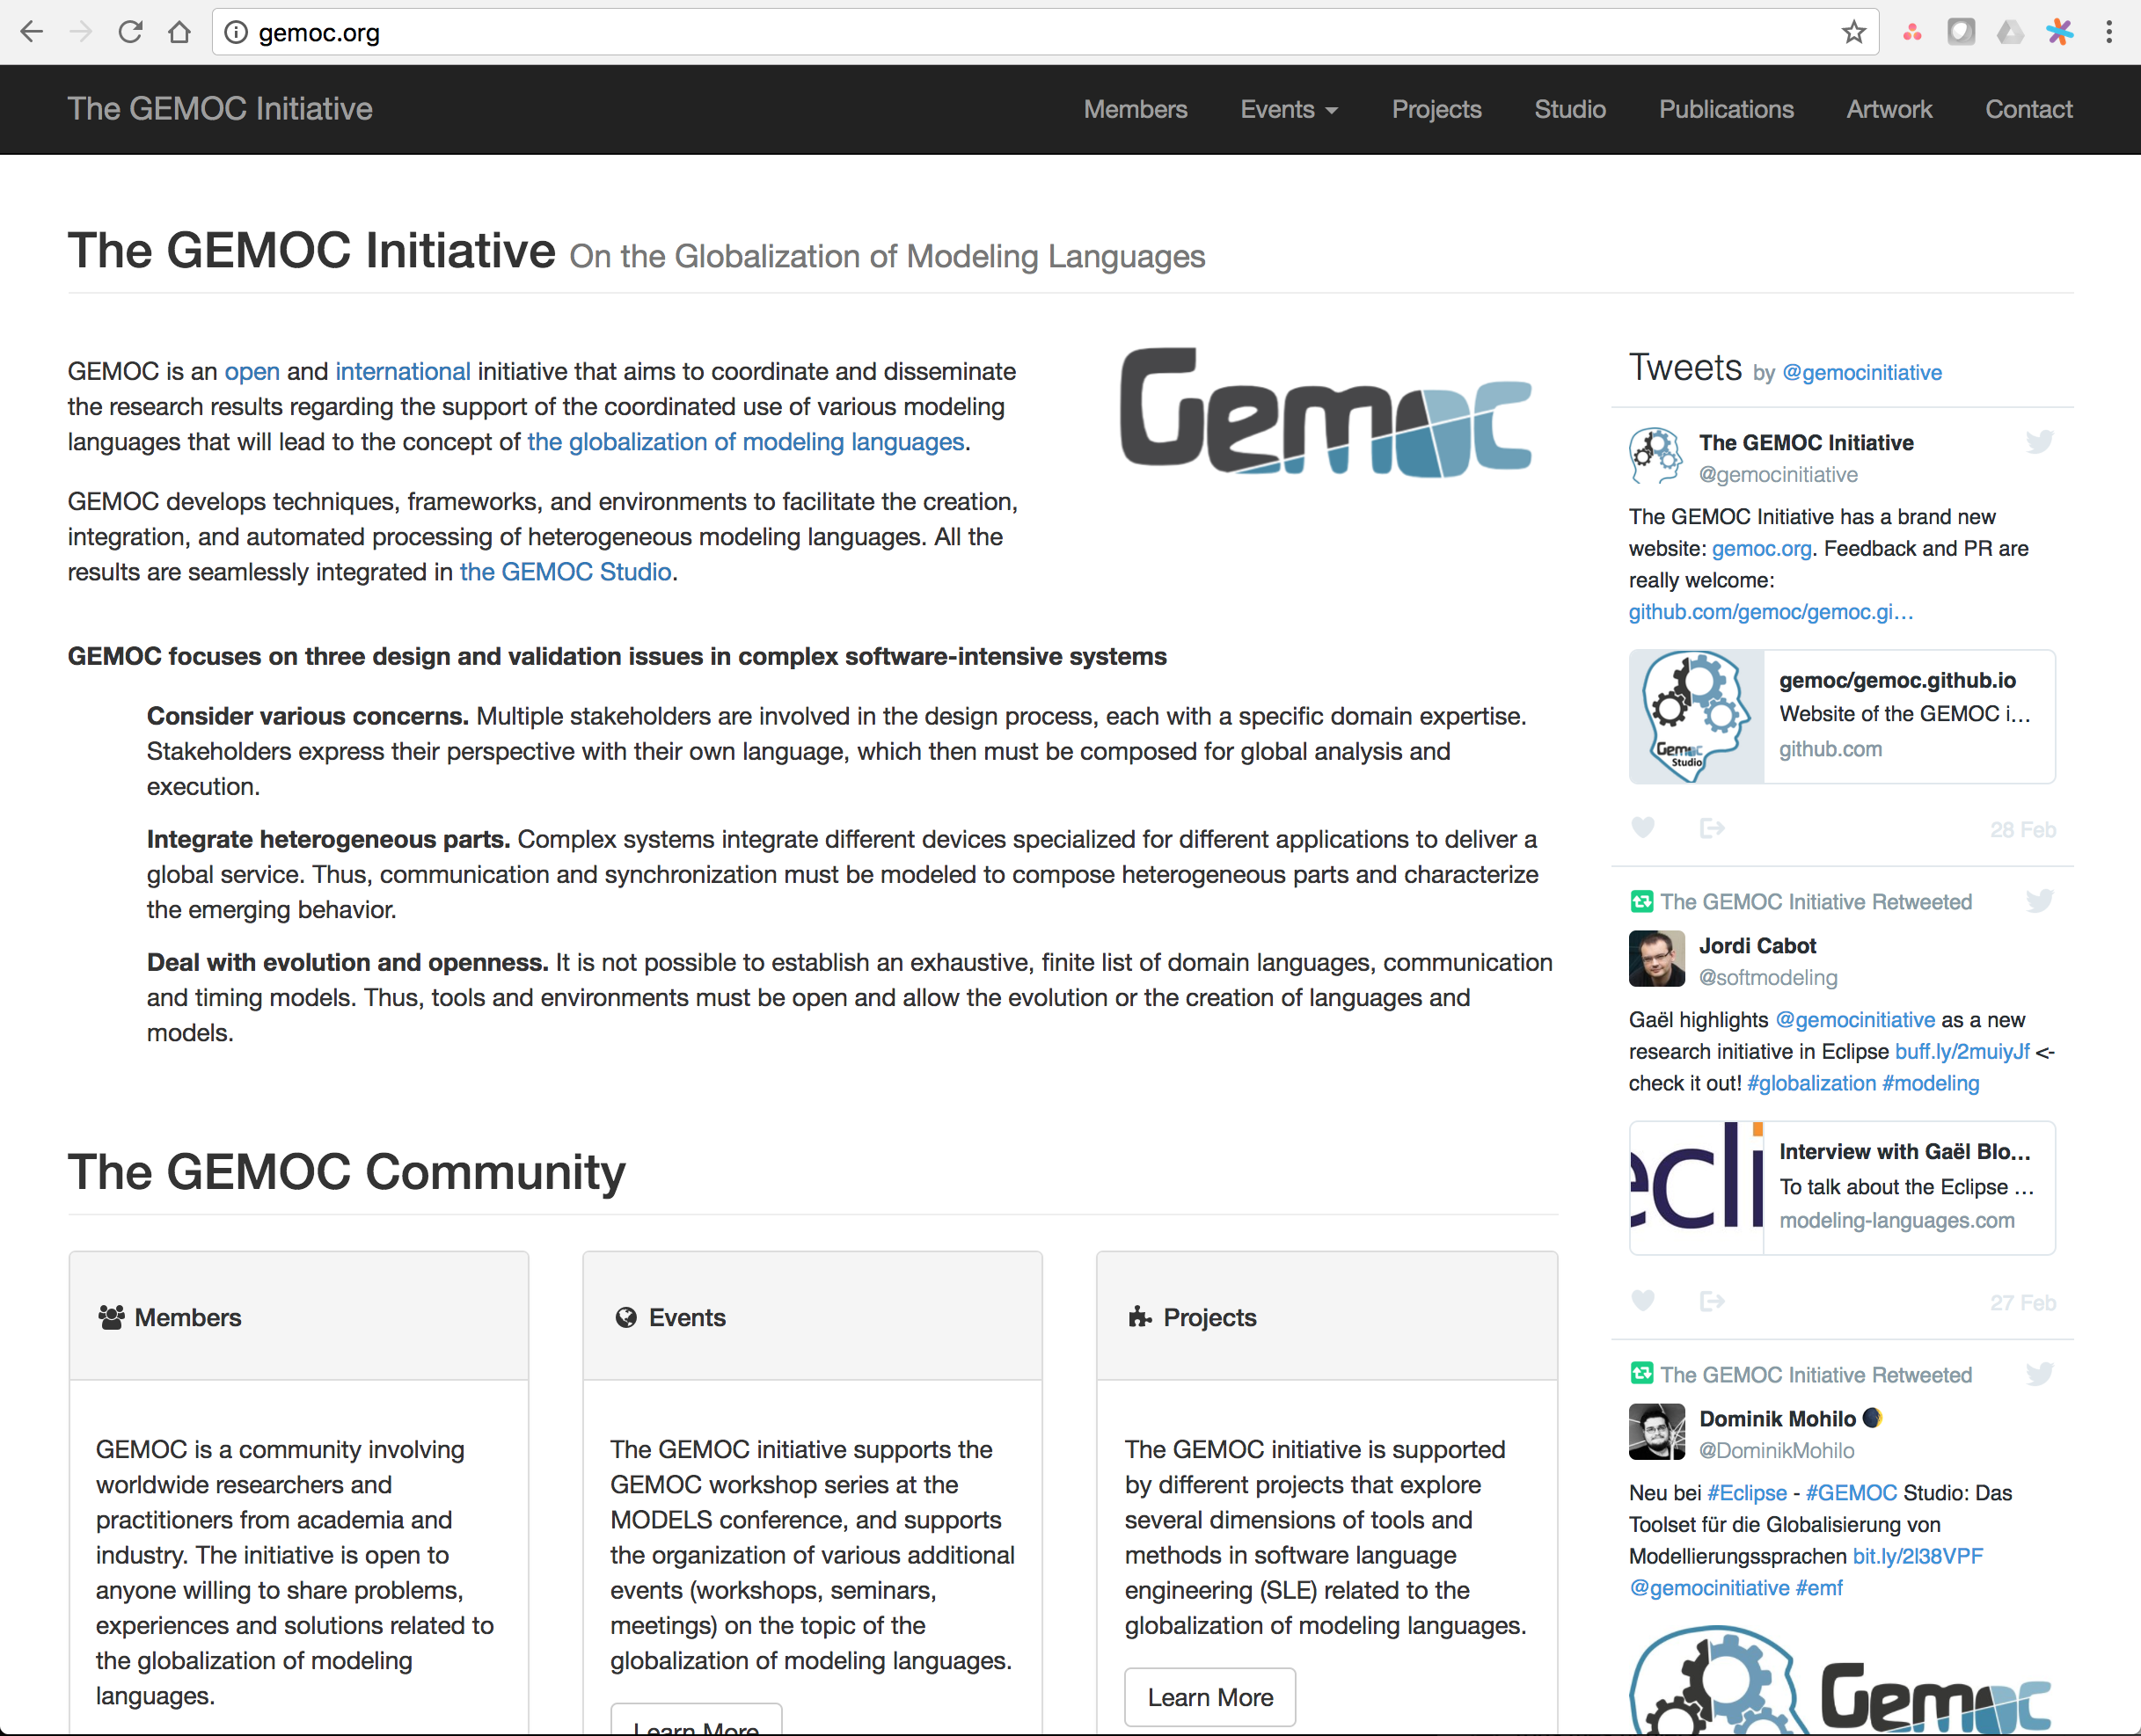
The GEMOC Website

Slide 13
The GEMOC Events
Workshop series at MODELS (since 2013)
Organization of 2 Dagstuhl seminars
Organization of 1 Bellairs workshop
Etc.

Slide 14



The GEMOC Studio
Research Consortium
Soon!
http://gemoc.org/studio
Language
Workbench
Modeling
Workbench
Design and compose your executable DSMLs
Edit and debug
your heterogeneous models

Slide 15
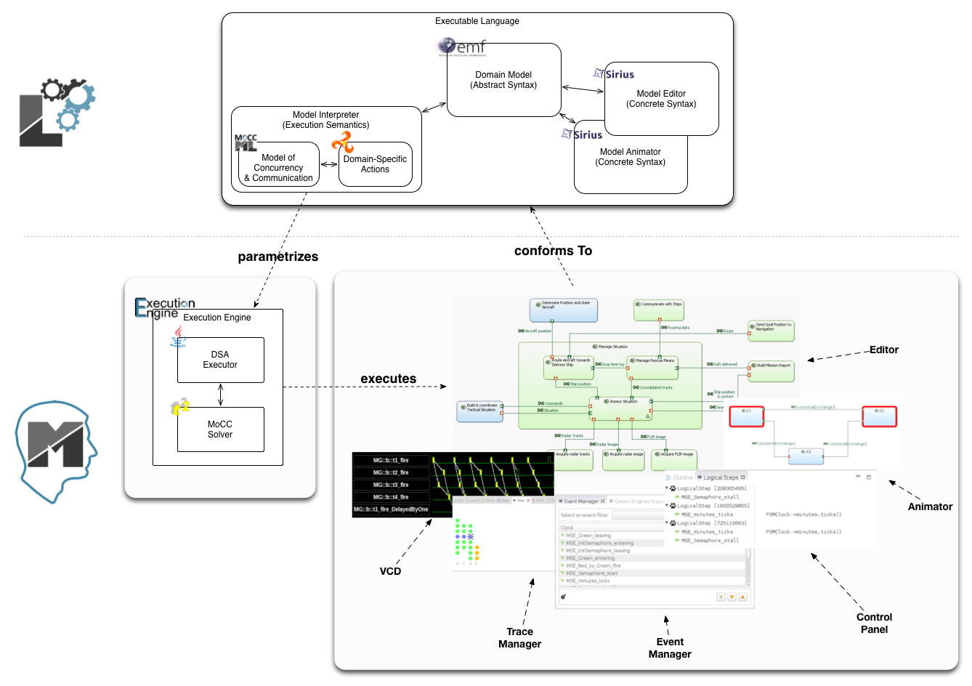
The GEMOC Studio
Benoit Combemale, Julien Deantoni, Olivier Barais, Arnaud Blouin, Erwan Bousse, Cédric Brun, Thomas Degueule and Didier Vojtisek, "A Solution to the TTC'15 Model Execution Case Using the GEMOC Studio," In 8th Transformation Tool Contest (TTC), 2015. Overall Winner
http://gemoc.org/studio/
The GEMOC Initiative – B. Combemale (Univ. Rennes 1) – 2017

Slide 16
Breathe Life Into Your Designer!
The GEMOC Initiative – B. Combemale (Univ. Rennes 1) – 2017

Slide 17
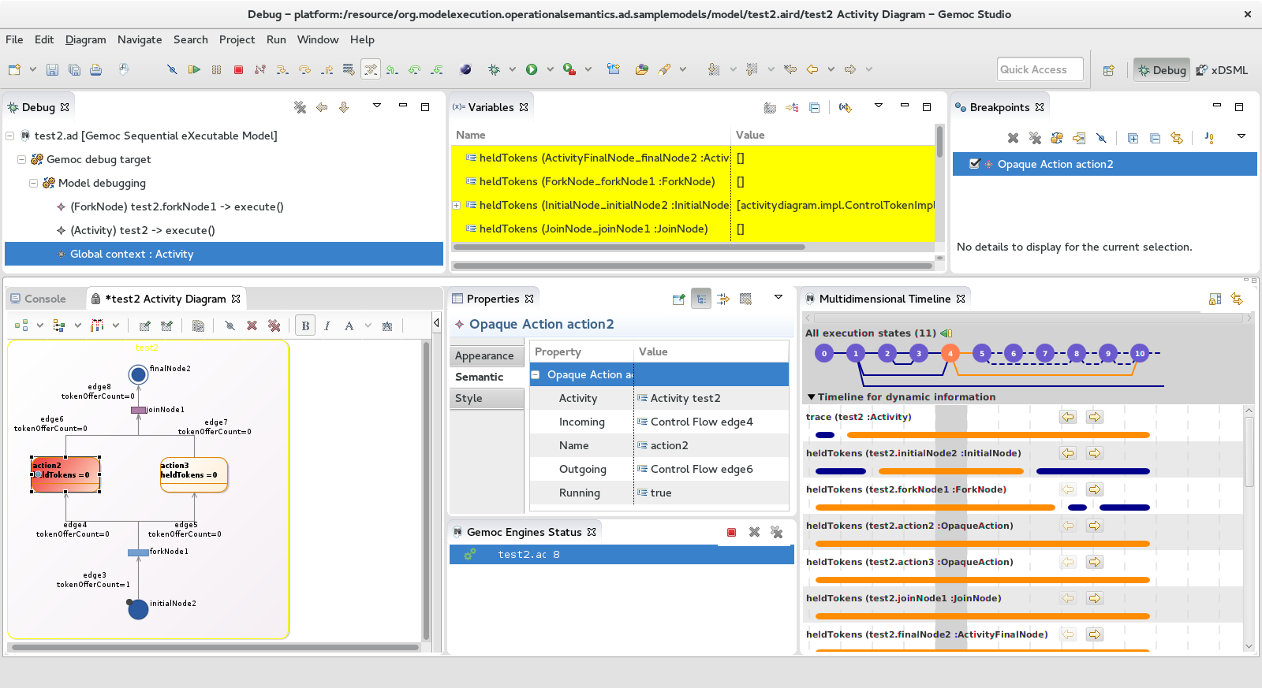
Activity Diagram Debugger
https://github.com/gemoc/activitydiagram
The GEMOC Initiative – B. Combemale (Univ. Rennes 1) – 2017

Slide 18
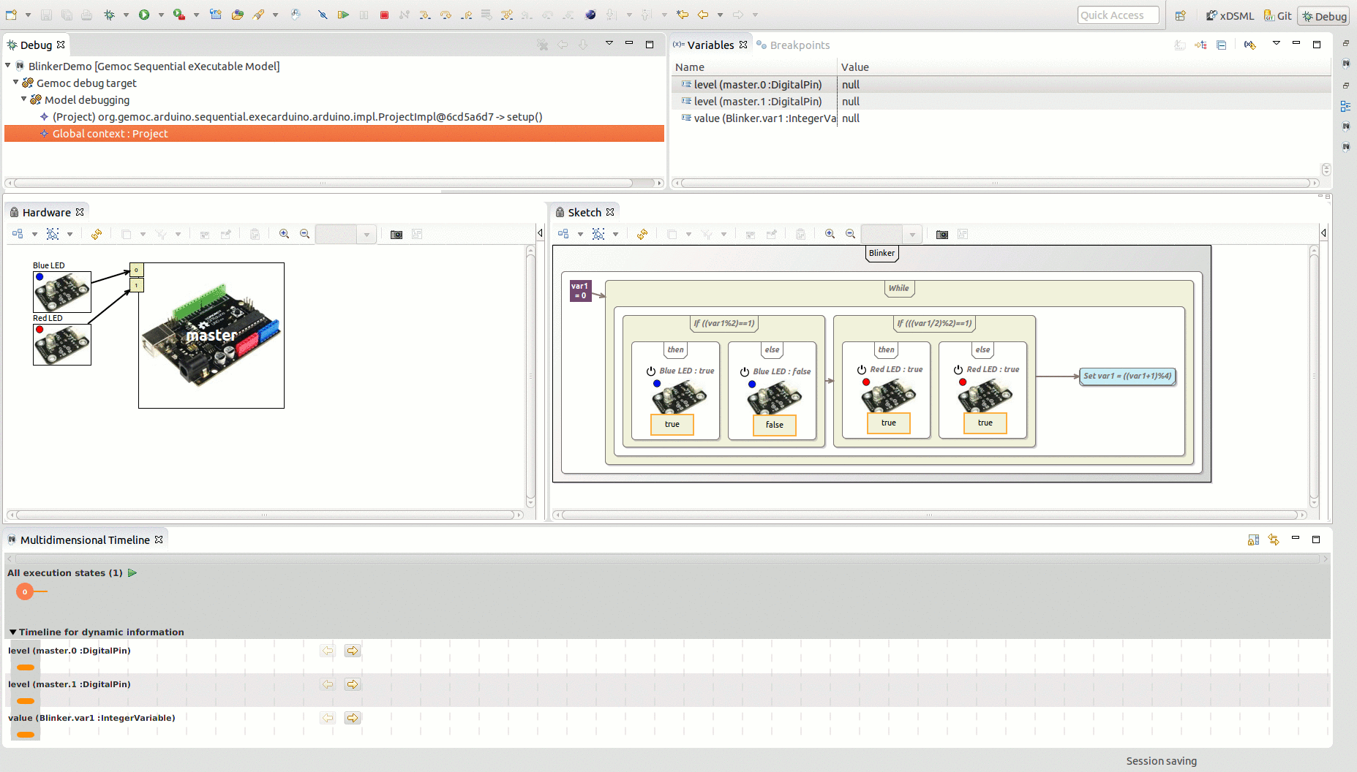
Arduino Designer (& Debugger)
https://github.com/gemoc/arduinomodeling

Slide 19
Transformation Lg Debugger
TETRABox
http://modeltransformation.net/tetrabox/
Wimmer, Bousse et al.
https://github.com/tetrabox/minitl

Slide 20
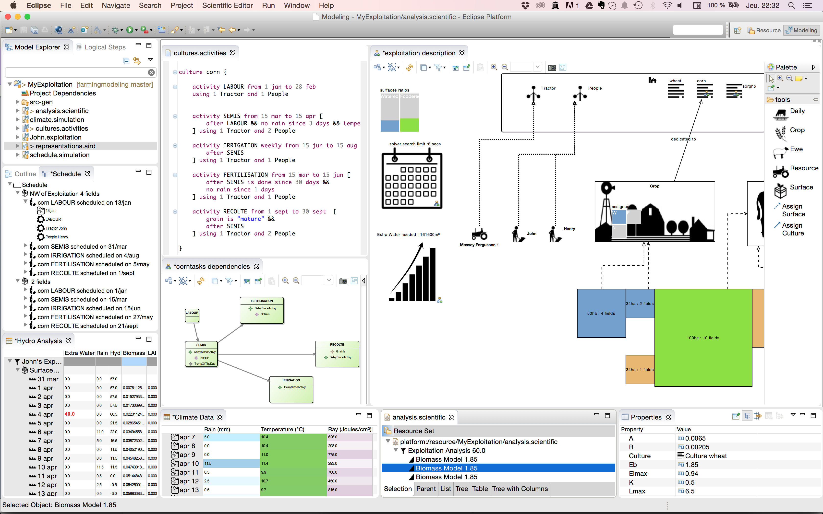
Farming System Modeling
https://github.com/gemoc/farmingmodeling
The GEMOC Initiative – B. Combemale (Univ. Rennes 1) – 2017

Slide 21
Weave Concurrency Constraints Into Your DSL!
Benoit Combemale, Julien Deantoni, Matias Vara Larsen, Frédéric Mallet, Olivier Barais, Benoit Baudry, Robert France, "Reifying Concurrency for Executable Metamodeling," In Software Language Engineering (SLE), 2013
The GEMOC Initiative – B. Combemale (Univ. Rennes 1) – 2017

Slide 22
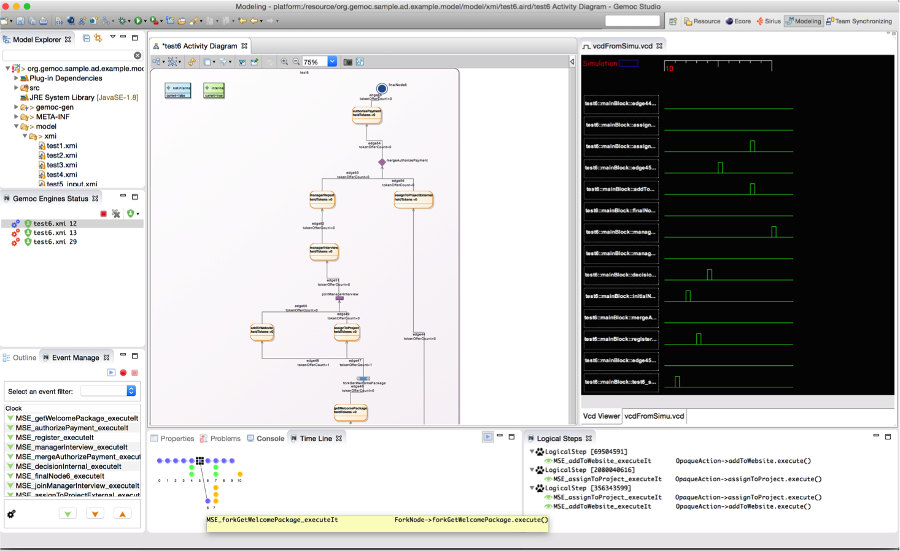
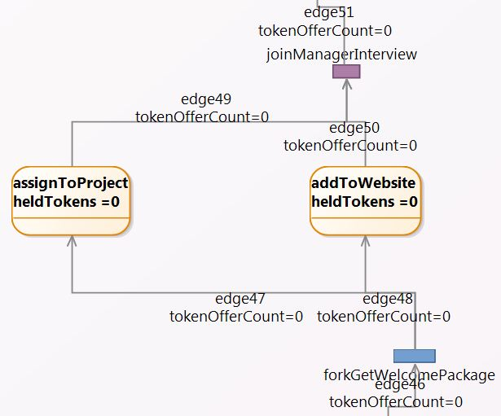
Activity Diagram Debugger
Benoit Combemale, Julien Deantoni, Matias Vara Larsen, Frédéric Mallet, Olivier Barais, Benoit Baudry, Robert France, "Reifying Concurrency for Executable Metamodeling," In Software Language Engineering (SLE), 2013

Slide 23
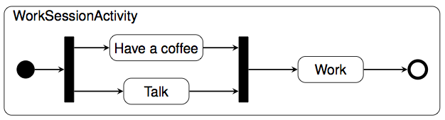
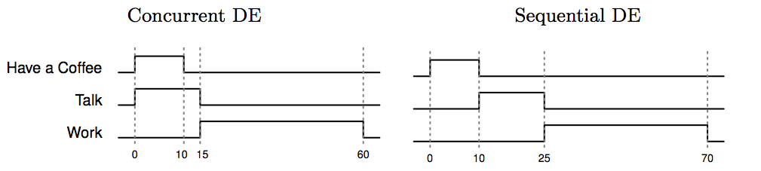
Coping with Semantic Variation Points
Florent Latombe, Xavier Crégut, Julien Deantoni, Marc Pantel, Benoit Combemale, "Coping with Semantic Variation Points in Domain-Specific Modeling Languages", In EXE@MoDELS 2015.
The GEMOC Initiative – B. Combemale (Univ. Rennes 1) – 2017

Slide 24

Reifying Concurrency and Coordination in xDSML
MoccML
Kermeta
Ecore
B-COoL
MoccML
The GEMOC Initiative – B. Combemale (Univ. Rennes 1) – 2017

Slide 25

Behavioral Model Coordination
Matias Ezequiel Vara Larsen, Julien Deantoni, Benoit Combemale, Frédéric Mallet, "A Behavioral Coordination Operator Language (BCOoL)," In MODELS 2015

